Slide 1
CASTOR Monitoring developments
Theodoros Rekatsinas, Witek Pokorski, Dennis Waldron, Dirk Duellmann,
19.02.2009

Slide 2
Outline
Motivation
Approach
Implementation details
Examples
Conclusion

Slide 3
Motivation
CASTOR is lacking a dedicated monitoring system
For end-users to see the status of the system
For operators to quickly spot and understand problems
For developers to efficiently test new setups (garbage collection, recall policy, etc)
Existing DLF tables contain a lot of information but would require complex and expensive queries to be used for monitoring

Slide 4
Approach
Use the existing logging system as the starting point
Profit from the work already done rather than start from scratch
consolidation rather than revolution
Limit the number of new requirements on the CASTOR code
monitoring should help to solve problems and not introduce new ones
Eventually improve and extend the existing log messages to contain any missing information

Slide 5
Approach
Monitoring
Tables
DLF
deamons
DLF tables
SQL
PHP
WEB
Interface
SQL monitoring procedures run every 5 minutes and pre-process incoming DLF messages
Monitoring tables correspond to specific metrics
Can be easily queried to provide necessary monitoring information
Web interface provides visualisation (histograms, pie-charts, etc) of the monitoring data

Slide 6
Approach
Monitoring tables (DB) isolate the front-end (web interface) from the back-end (transport for log messages)
Both can be changed in the future
DLF to SYSLOG
Web interface redesigned
Several web interfaces can be simultaneously implemented
Summary dashboard for experiments
Detailed monitoring for developers and operators

Slide 7
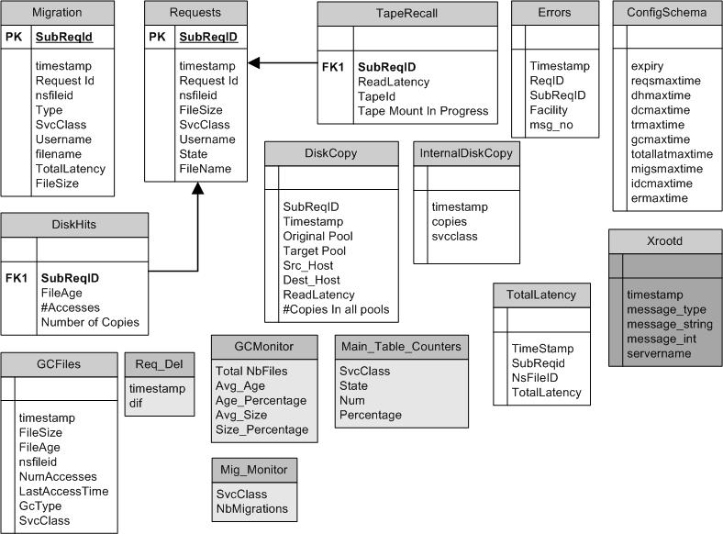
Monitoring schema
Deployed in the same DB as DLF
but in a different account
Populated by SQL procedures
(running period: 5 minutes)

Slide 8
Monitoring schema
Requests
Contains general information about every read-file request
Requests:
Requests for Resident Files (DiskHits)
Inter-Pool Copies (DiskCopies)
Tape Recalls

Slide 9
Monitoring schema
Request Classification
Unique fields for each sub-category

Slide 10
Monitoring schema
Garbage Collection
Information regarding Garbage Collected files (file age, #accesses, size etc)
Log requests for recently garbage collected files (Req_Del)

Slide 11
Monitoring schema
Errors
Store errors per facility

Slide 12
Monitoring schema
Total Latency
Read-file request latency

Slide 13
Monitoring schema
Migration
Information about file migrations to tape (SvcClass ,Latency, Filename etc.)

Slide 14
Monitoring schema
Auxiliary Views
Used by castor dashboard

Slide 15
Monitoring web interface
One web portal per CASTOR instance
The interface consists of two different levels
Current Status Dashboard
Statistical Information
All plots are created using JpGraph libraries
JpGraph’s caching mechanism used for image caching
Deployed on the same server as DLF interface

Slide 16
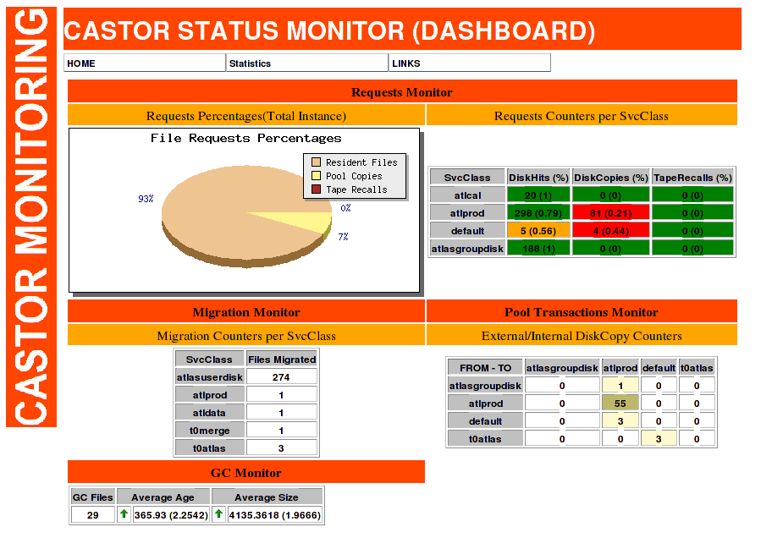
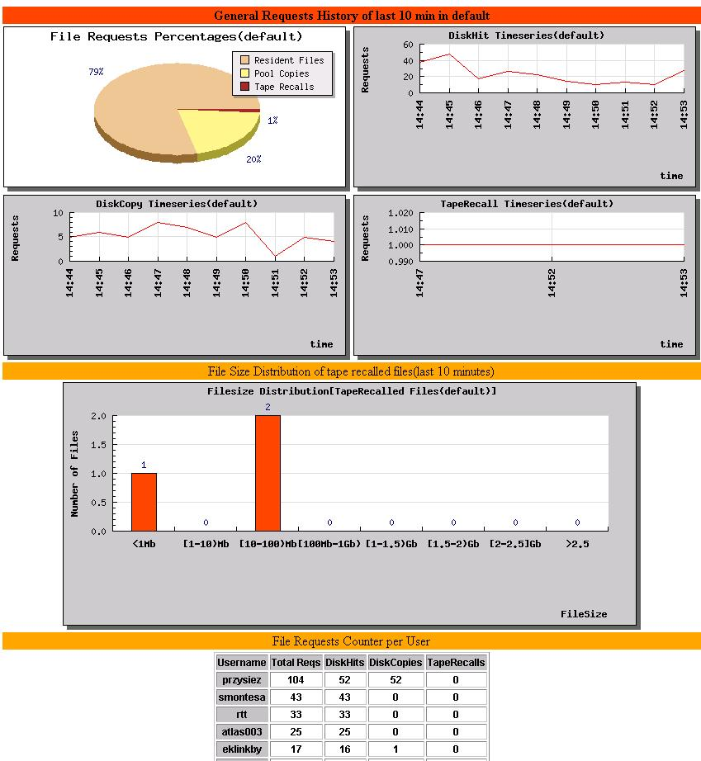
Monitoring web interface
Click on field to get extra information
view statistical
information
GC Information

Slide 17
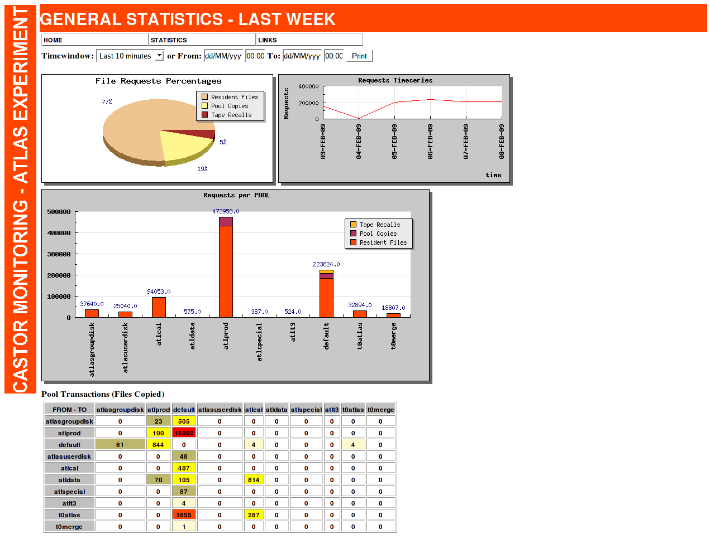
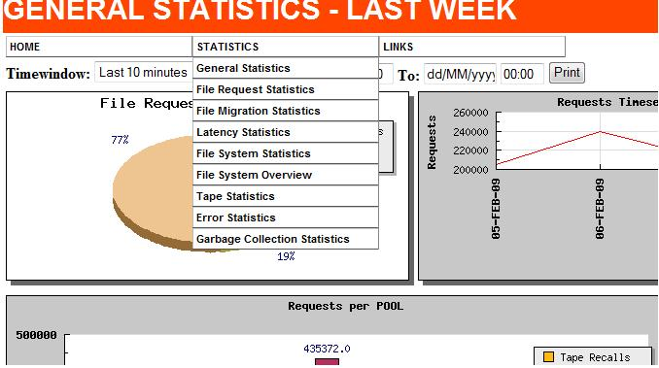
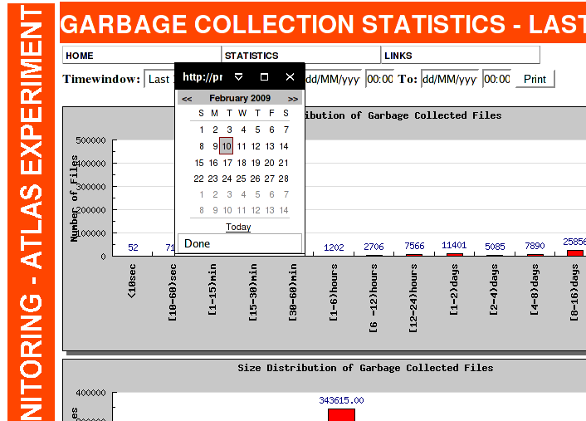
Monitoring web interface
Select different statistical information
from a drop down menu
Select predefined or custom
time window

Slide 18
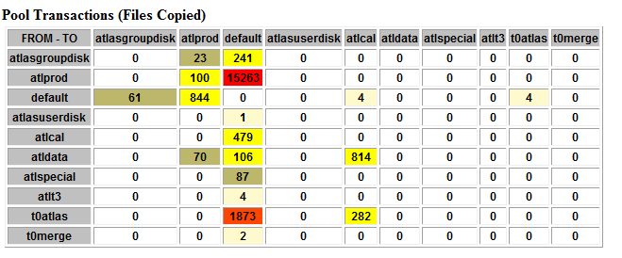
Examples

Slide 19
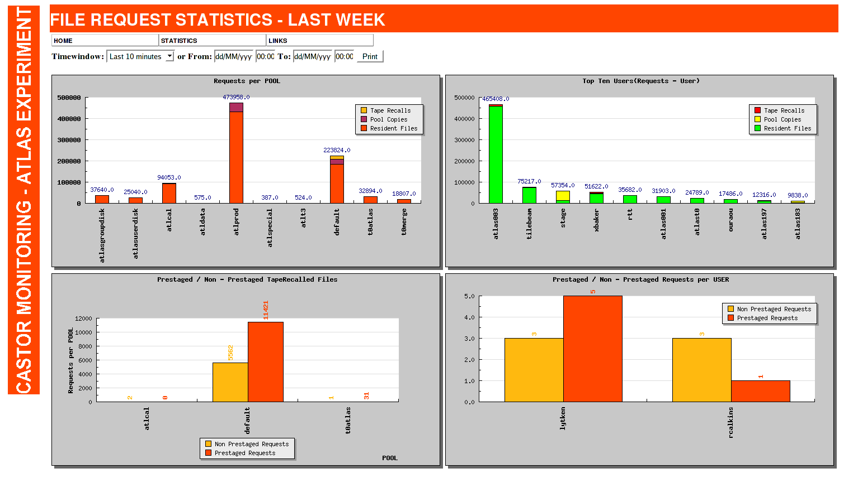
Examples

Slide 20
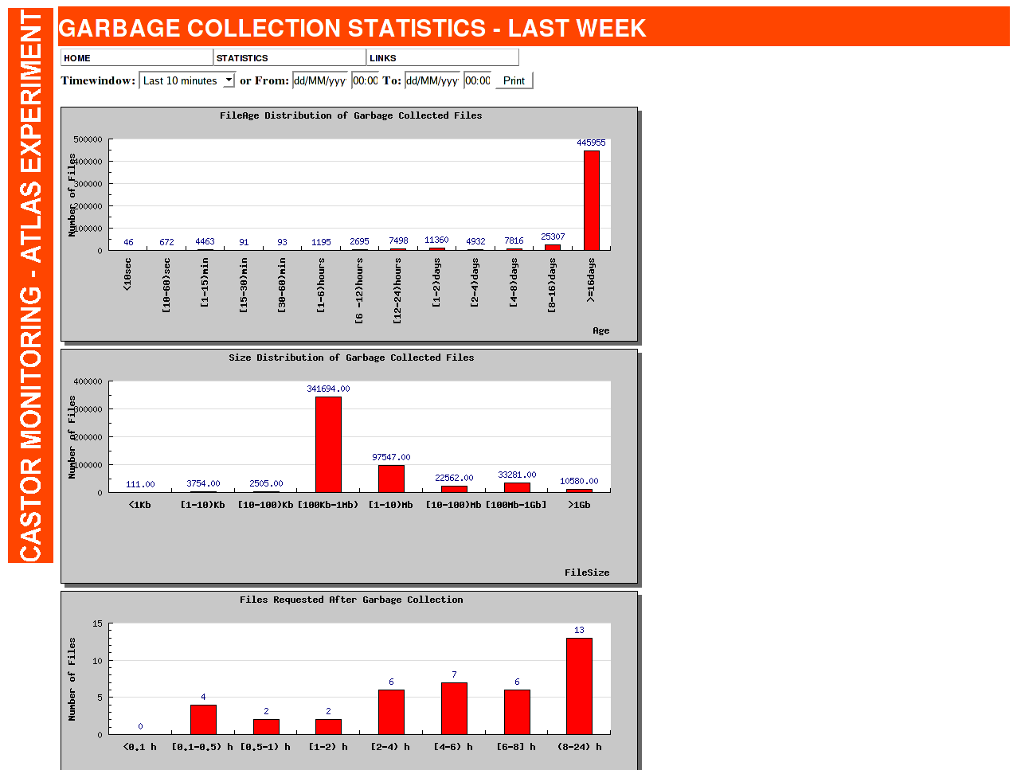
Examples

Slide 21
Examples

Slide 22
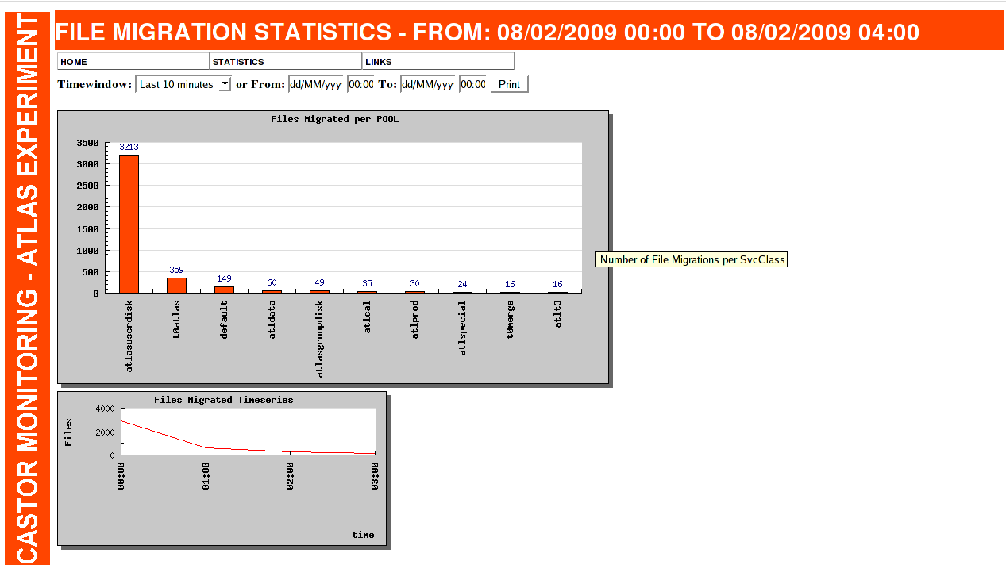
Examples

Slide 23
Conclusion
New CASTOR monitoring provides a number of metrics not available until now
The system is ready to be used
part of release 2.1.8-6
Monitoring web interface allows visualisation of the system status and history
Presented as overview (dashboard) or detailed
For preview: http://cern.ch/castor-monitoring but(!) this is our development instance (little data available)
Further extension (new metrics, new plots) can be easily added

