Slide 1
CERN Diskserver
Deployment
Ignacio Reguero, Jan van Eldik, Miguel Santos
Castor Operations Team
IT/FIO
CERN

Slide 2
Outline
What complexity?
Diskserver hardware
Diskserver configurations
Time evolution
Configuration management
Quattor in a nutshell
Castor configuration
Conclusions

Slide 3
Hardware complexity
Diskserver hardware at CERN today
1000+ NAS boxes
Providing 3.5 – 7 TB on 2 – 7 XFS filesystems
12 distinct h/w types, with different
Types/number of RAID controllers
Types/number of disk drives
Operational problems ☺
Warranty period of 3 years
Replacing them should become a standard (ie cheap) operation
Technology will change (of course)

Slide 4
Diskserver Hardware
Reminder:
Bigger disks may not be useful without appropriate IO performance
Disk space is not very useful if you cannot access it
In any case you need as many spindles as possible
And again, technology will change
Considering RAID2 (Mirroring) to replace RAID5 in new models

Slide 5
Diskserver Hardware Example
Miguel Santos traced machines of the same type in production for one week
Comparing behaviour with different number of RAID units
To produce a scatterplot of Iowait X network throughput delivered

Slide 6
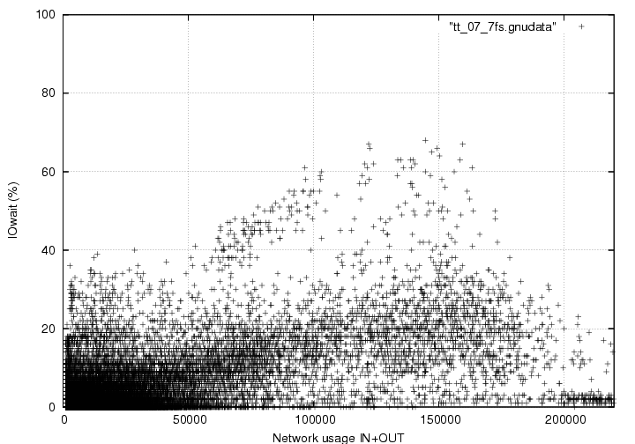
tt_07 7 RAID Units

Slide 7
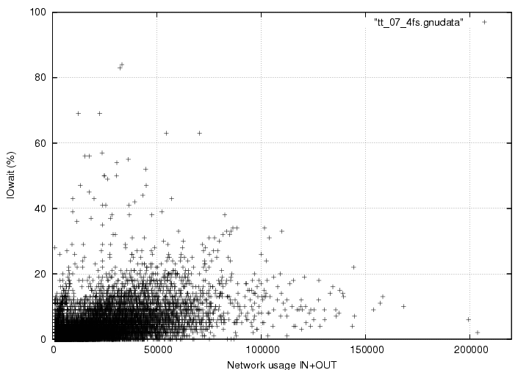
tt_07 4 RAID Units

Slide 8
tt_07
Conclusion:
No dots in the high performance side + high latency dots, so
Reducing from 7 to 4 RAID units saves some disk space but severely limits your IO performance

Slide 9
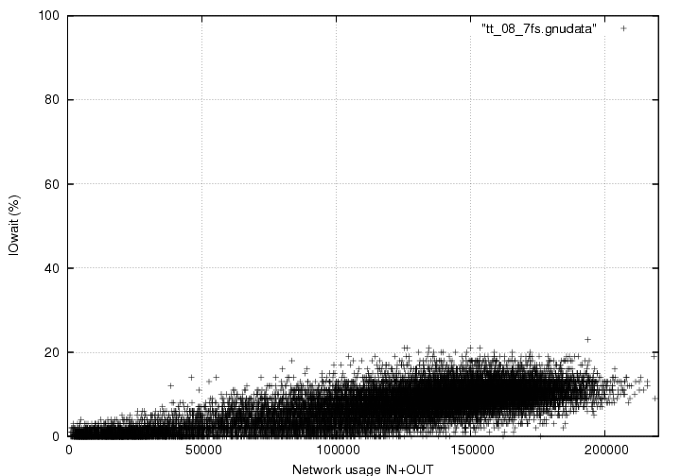
tt_08 7 RAID Units

Slide 10
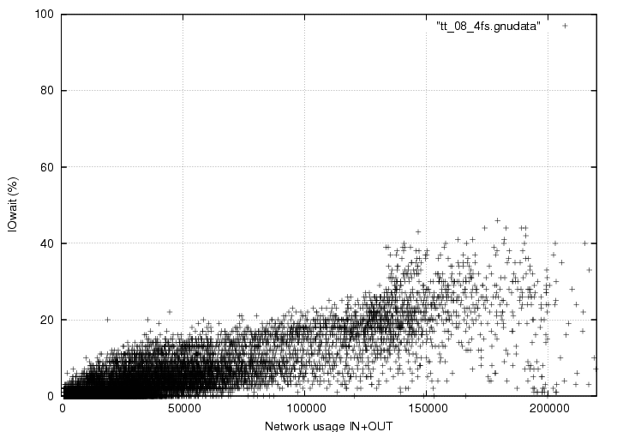
tt_08 4 RAID Units

Slide 11
tt_08
Conclusion:
Reducing from 7 to 4 RAID units shows higher latencies and less dots in the high performance side of the plot.

Slide 12
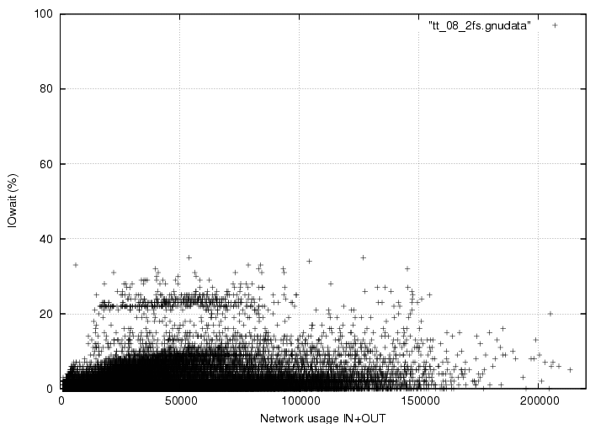
tt_08 2 RAID Units

Slide 13
tt_08
Conclusion:
With 2 RAID units you see
Performance limitation
A bigger than 20% Iowait mode that we think is coupled with the diskserver acting as a “hot spot”.
A “hot spot” keeps attracting requests that it is not able to service thus preventing a service class to work until it is disabled.

Slide 14
Configuration complexity
Today, we run 6 production instances…
Atlas, CMS, Alice, LHCb, Public
“cernt3” shared analysis instance
… with 46 service classes
~ 50% of type D1T0
Biggest: cmscaf: 216 servers, 1 PB
Many of them have ACLs
Some of those automatically synchronized with LSF groups defined for batch cluster
Supporting different access protocols
Rfio, root, gridftp (int and ext…), xroot

Slide 15
What’s next?
Lots of things:
SLC5
Xrootd
New storage technologies
Security
D2T0?
How to efficiently operate a complex product like Castor in this complex environment?
Answers on the next slide!

Slide 16
Et voila!
(Try to) keep things simple
Easier said than done
User education helps a lot
Discuss/dissect requirements, explain limitations and operational issues, find compromises, …
Give feedback to the developers
Yes, they do understand operational reality ☺
Keep a tight control of your configurations
Automate, avoid handwork
Fabric management tools are essential!

Slide 17
ELFms tool suite @ CERN
Quattor
Software installation & configuration
Lemon
Fabric Monitoring: Alarms, recovery actions, plotting
SMS State Management System
Move diskservers into / out of production

Slide 18
Quattor concepts
Describe servers in “template files”
Hardware, software packages, configuration details, monitoring, etc.
Templates can include templates
Can build elaborate structures
Description language PAN
Not always intuitive or user friendly
Information is distributed to the servers
“NCM components” configure the machines

Slide 19
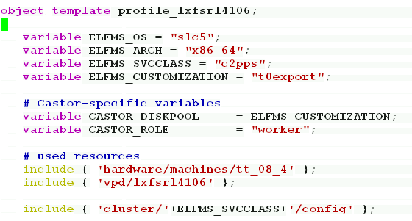
Template examples
Diskserver lxfsrl4106 (simplified)

Slide 20
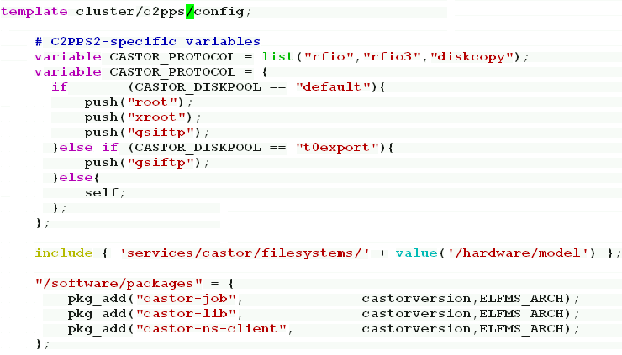
Variables, includes, s/w pkgs

Slide 21
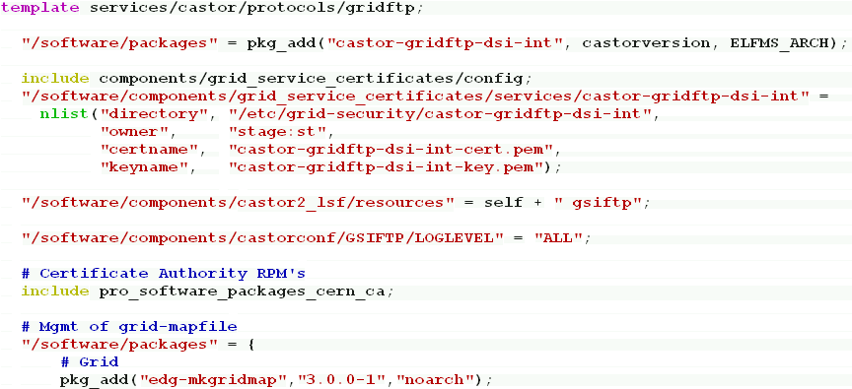
Gridftp template
s/w packages, 3 different components, inclusion of CA RPM’s

Slide 22
NCM components
General purpose
chkconfig, sysctl, sysconfig, ntpd, iptables, grub, modprobe, ipmi, authconfig, accounts, …
Castor specific
castor2_lsf, castorconf, castor2_xrootd, localgridmap, grid_service_certificates
Note: components can have pre/post dependencies on each other

Slide 23
ncm-castorconf
Writes /etc/castor/castor.conf
Based on /etc/castor/castor.conf.example
Simple triplets “key1 key2 value”

Slide 24
Ncm-castor2_lsf
Generates all LSF config files for CASTOR
Motivated by the need to synchronize the diskserver configuration between the stager DB and LSF
Using the config in CDB as reference
Thus avoids both nasty
Diskserver in DB but not in LSF
Diskserver in LSF but not in DB

Slide 25
Ncm-castor2_lsf
Recently extended to configure per protocol LSF limits :
rfio, rfio3, root, xroot, gridftp, gsiftp, diskcopy
This is important because streaming transfers (rfio3, diskcopy) hit heavier the disk server then other type of transfers
So the scheduling slots for one activity may be wrong for another
This may help to avoid replication traffic to overwhelm diskservers

Slide 26
ncm- grid_service_certificates
Copy host certificates to other directories, and change ownership
Triggered by the sindes component that distributes the files
Used for gridftp service certificates
Example on the gridftp template

Slide 27
ncm-castor2_localhosts
Write /etc/castor/castor.localhosts
With all the subnets allowed for rfio
Question: is this feature still useful? Or could it be replaced by firewall rules?

Slide 28
Core dumping
ncm-sysctl:
kernel.suid_dumpable = 1 (SLC4)
fs.suid_dumpable = 1 (SLC5)
ncm-sysconfig:
DAEMON_COREFILE_LIMIT =unlimited
Configured for all core components
stager, rhserver, rtcpclientd, expertd, …

Slide 29
Cron jobs
ncm-cron: write entries in /etc/cron.d/
Used on gridftp servers to kill gridftp processes older than 4 hours:
Uses simple perl script “oldprocesskiller”
Was useful on SRM 1.3 as well ☺
RPM available, let us know if you want it

Slide 30
Logrotate entries
ncm-altlogrotate writes entries in /etc/logrotate.d/
Re-define policies for Castor log file rotation (store them for 200 days)
WLCG logging requirement
Debugging

Slide 31
Quattor limitations
Template structure can become very complex
And changing it is hard

Slide 32
Time Evolution
Most disk server operations can be reduced to a number of
Add new disk servers
Drain and remove disk servers
Examples
Service class reconfiguration
HW problem on a disk server
Out Of Warranty removal
(Move in + drain + move out) X N
You do need fabric mgmt tools to efficiently manage groups of machines

Slide 33
Moving a diskserver out (summary) 1
Put diskserver in DRAINING
sms set standby quiescing "to move the server out" lxfsxxxxxx
Replicate required files
/cern.ch/user/s/stage/disknodeShutdown -n lxfsxxxxxx -a email@cern.ch -v 'STAGED|CANBEMIGR' -s svcclass
DISABLE diskserver
sms set maintenance "change cluster" "moving diskserver out of Castor2" lxfsXXXX

Slide 34
Moving a diskserver out (summary) 2
Clean obsolete diskcopies in DB
diskServer_qry lxfsXXX.cern.ch -d |grep /srv/castor/xxx | awk '{print $1}' | grep -v DiskCopyId | xargs cleanLostFiles
Wipeout filesystems
/usr/sbin/fileserver-datadisk-setup.sh --force --wipe --raw --prefix /srv/castor/
Edit CDB profile & reconfigure server
Remove diskserver from stager DB
rmAdminNode -d -n lxfsXXXX.cern.ch

Slide 35
Moving a diskserver in (summary) 1
Choose boxes, put in SMS maintenance
Update Quattor CDB profile
Get Grid Host Certificates
We have automated this procedure ☺
Reinstall diskservers
No “post-install” thanks to Quattor
In Scheduler regenerate LSF config files
ncm-ncd --configure castor2_lsf
Reconfig and restart LSF
lsadmin reconfig # only on the master node badmin reconfig; badmin mbdrestart

Slide 36
Moving a diskserver in (summary) 2
Move diskserver into diskpool and start rmmaster monitoring for the filesystems in the new server
diskserverinplace <hostname>...
This finds our the diskpool in CDB and calls moveDiskServer <diskpool> <hostname>.cern.ch and /usr/bin/rmAdminNode -R -r –n <hostname>.cern.ch
Put the node in production in SMS
sms set production none 'in production' <hostname>...

Slide 37
Conclusions
Castor configuration of diskservers:
Vary between VO’s, svcclasses, diskserver hardware, …
Evolve with new operating system versions, Castor releases, user requirements, …
Should be kept as simple as possible!
Keeping things simple…
… is very necessary
… is hard work
Fabric mgmt is indispensable!

